Slide 1
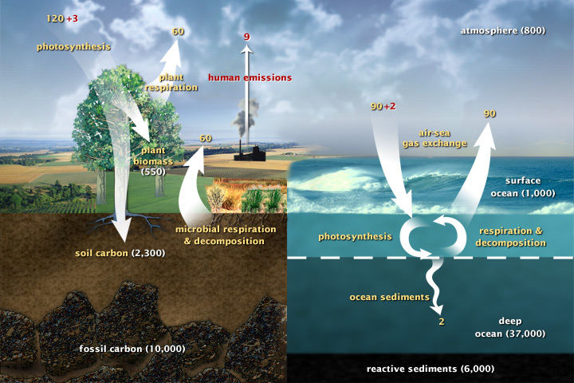
Carbon fluxes in Earth’s climate system

Slide 2
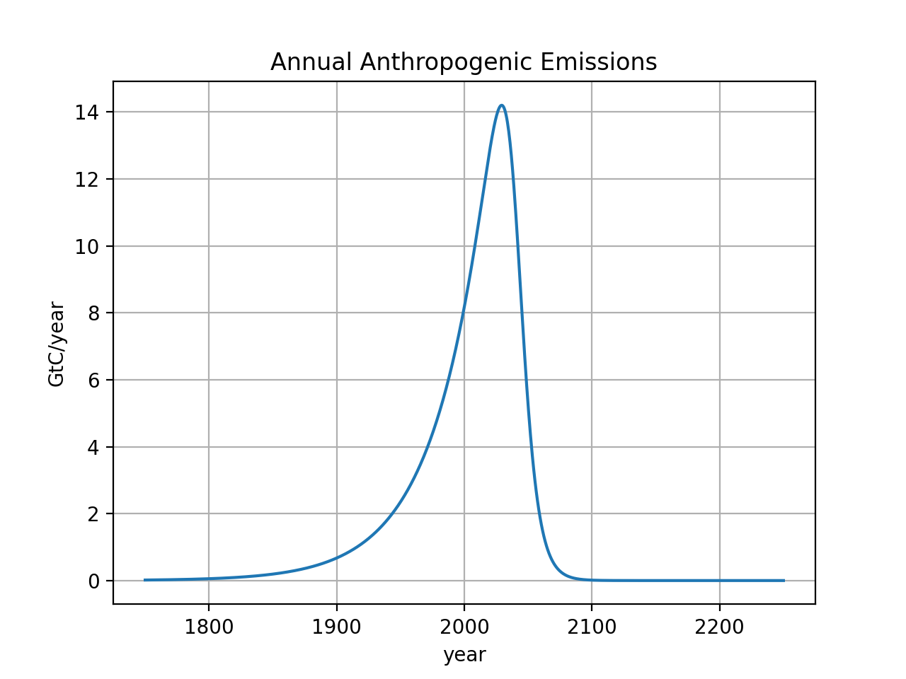
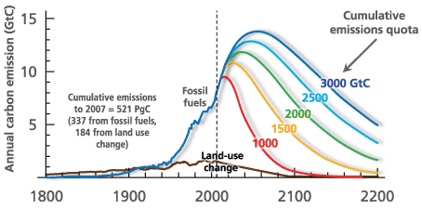
Cumulative analysis
http://www.igbp.net/news/features/features/havewereachedpeakco2.5.1b8ae20512db692f2a680003465.html
Notes:
http://www.igbp.net/news/features/features/havewereachedpeakco2.5.1b8ae20512db692f2a680003465.html

Slide 3
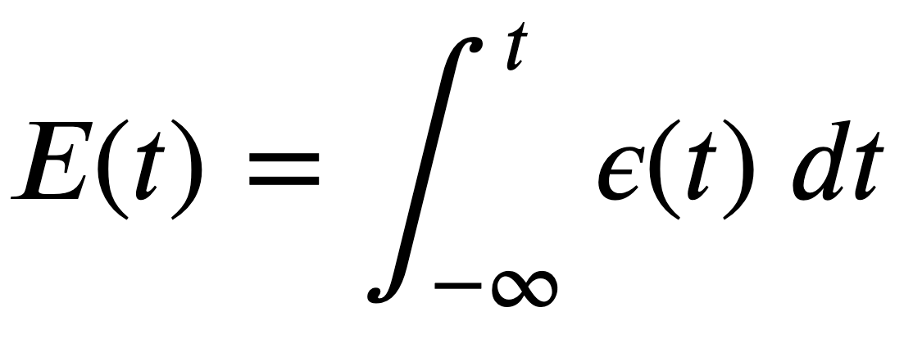
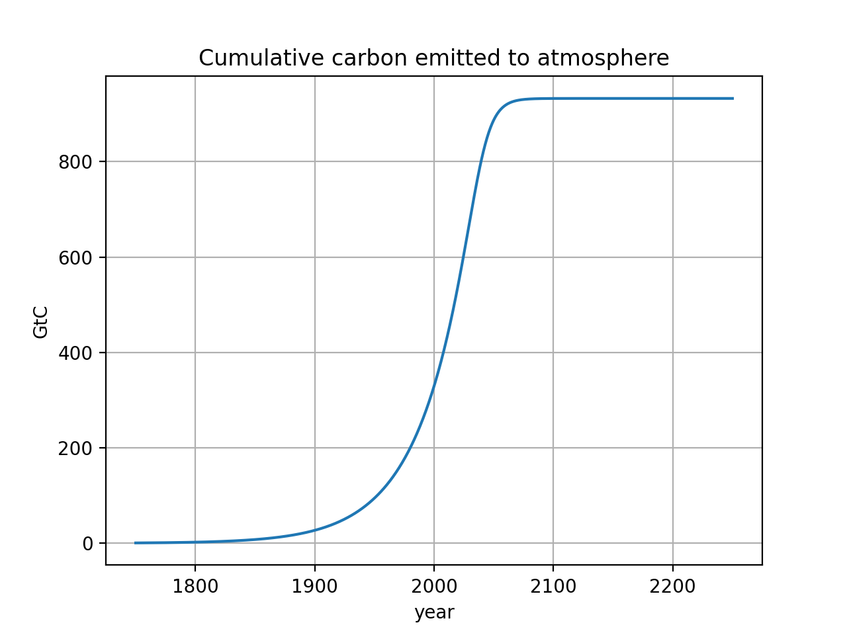
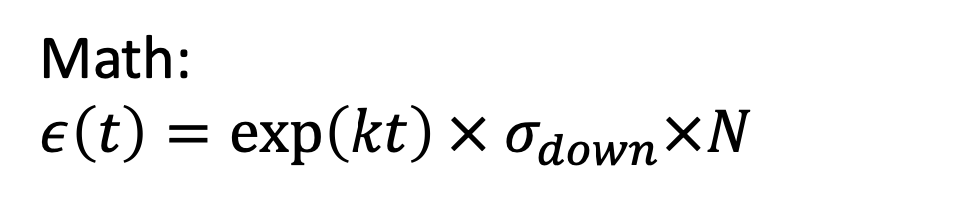
Math behind CumulativeAnalysis
Math:
$$ε\left(t\right)={\exp\left(kt\right)× σ}_{down}×N$$
Integral calculus math:
Almost 1000 GtC eventually burned
It’s thought that ~4000 GtC is the total Earth reserve, so ~75% will be left in the ground
In CumulativeAnalysis:
Notes:
http://www.igbp.net/news/features/features/havewereachedpeakco2.5.1b8ae20512db692f2a680003465.html

